Slide 1

Microphones

Slide 2
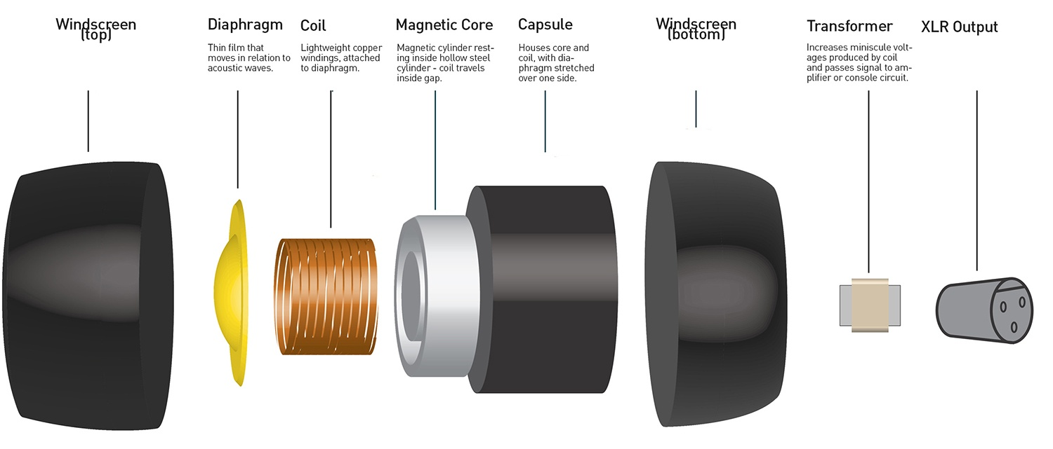
Microphone: Broken down
Notes:
When sound reaches the microphone, the diaphragm vibrates backwards and forwards. This causes the coil to vibrate which then changes the magnetic field produced by the magnet. Changes in the current are detected and a signal is output.

Slide 3
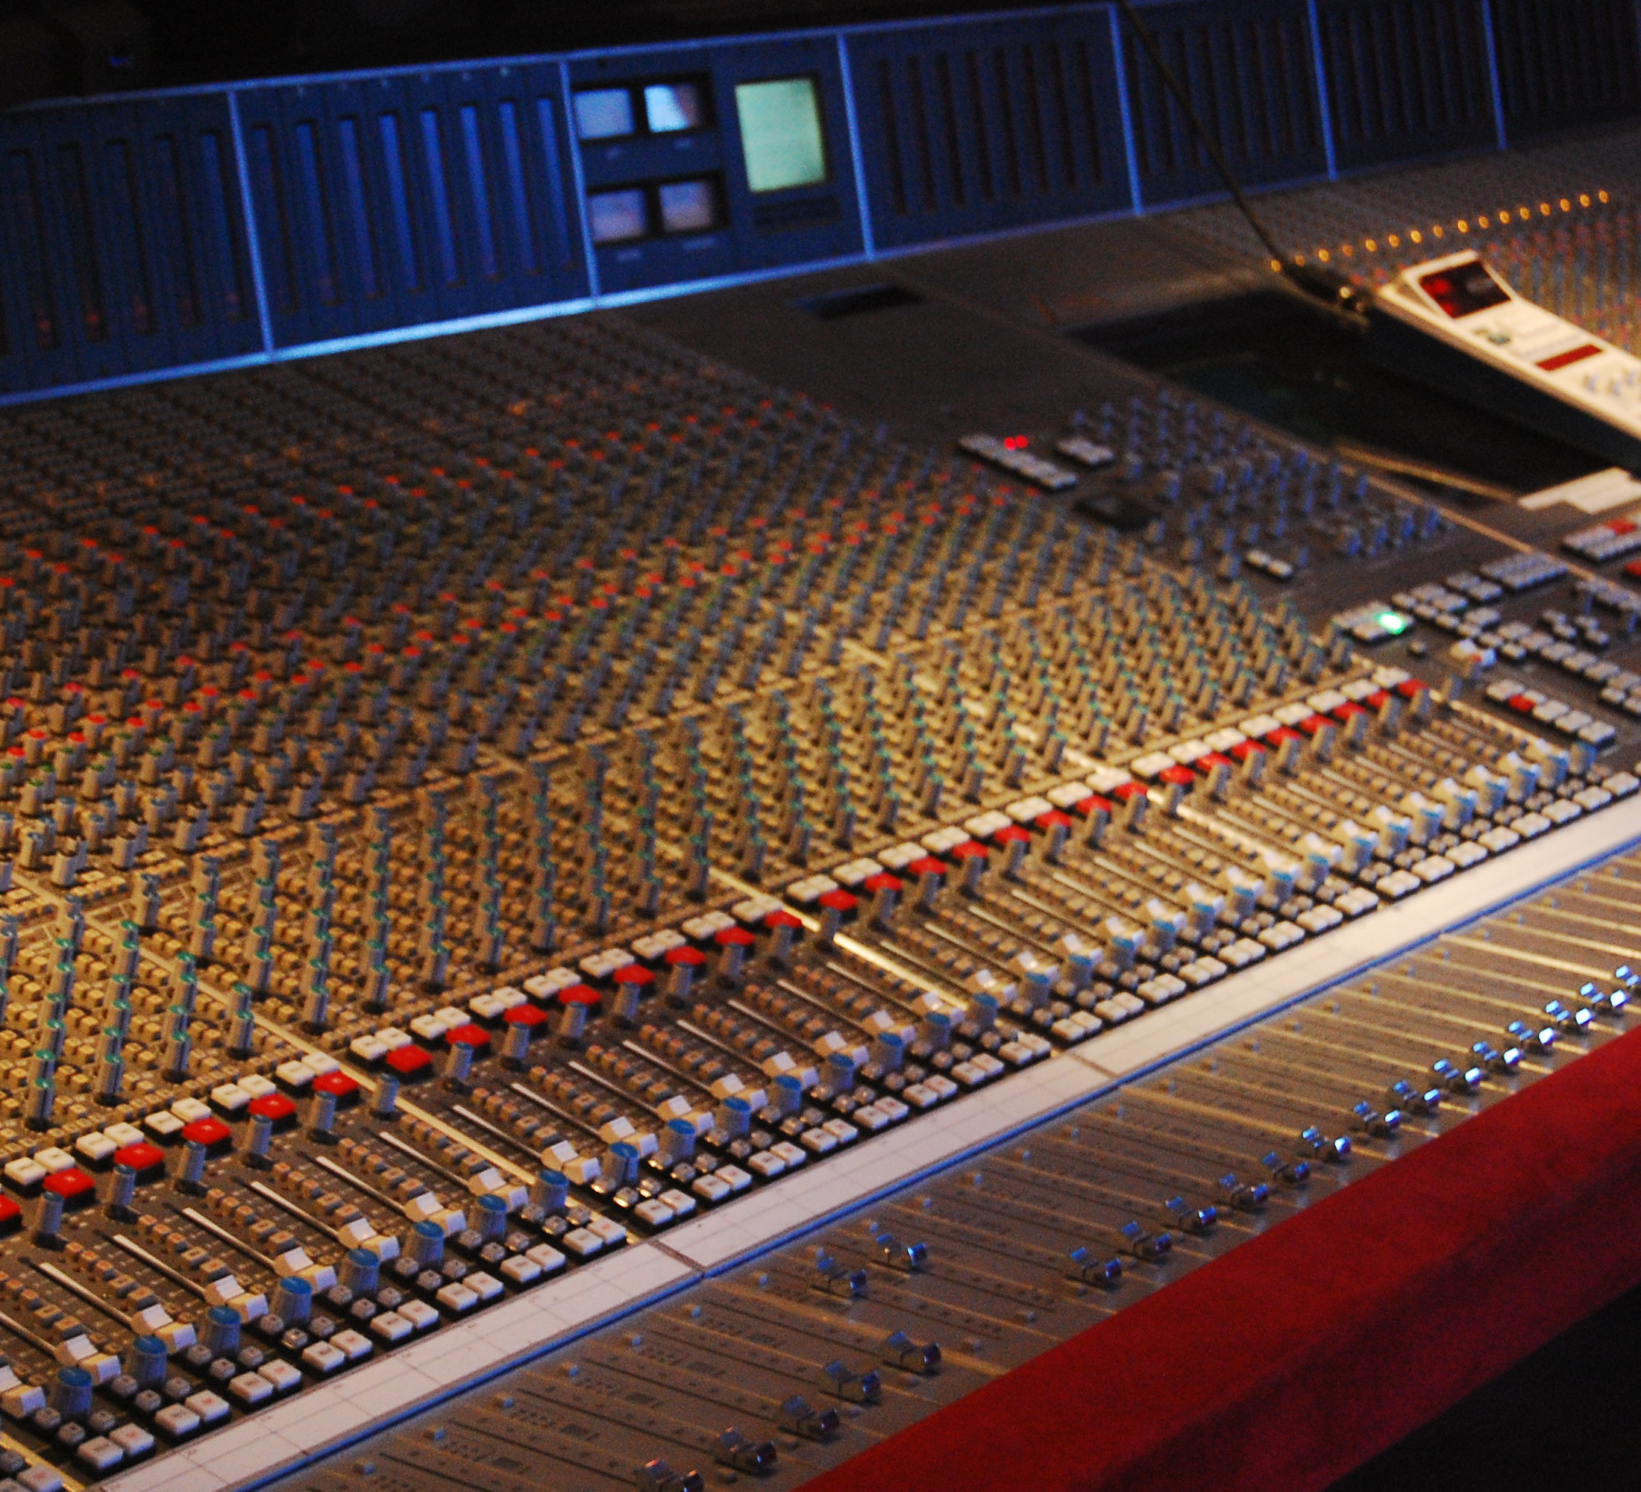
Sound Envelope

Slide 4
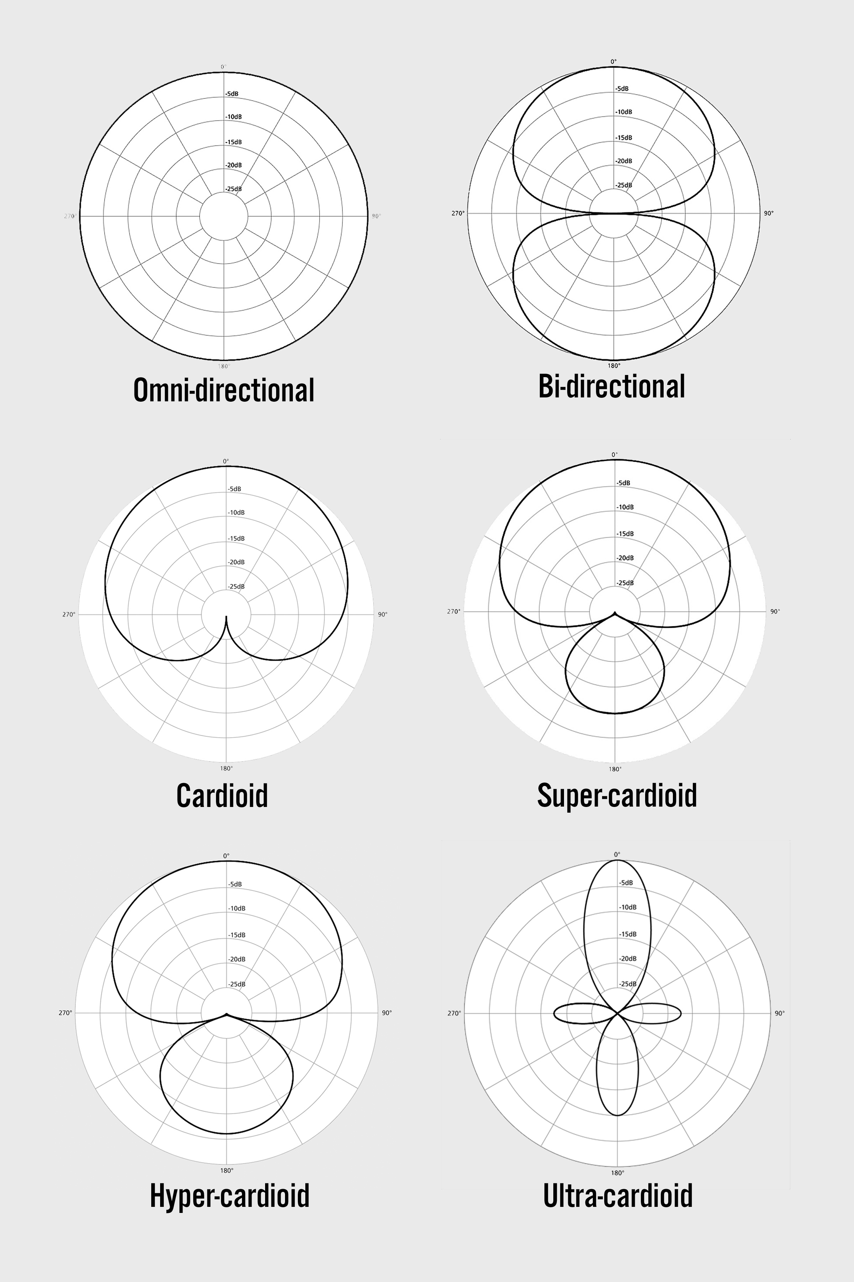
Omnidirectional
Omni – Latin for ‘all’
Picks up sound from all around it
Used for lavalliere mics (mics attached to the lapel of
an actor)

Slide 5
Cardioid
Most sensitive to the sound from the front of the mic
Least sensitive from behind the mic
Can be used in pairs to capture stereo sound
Mostly used for music productions

Slide 6
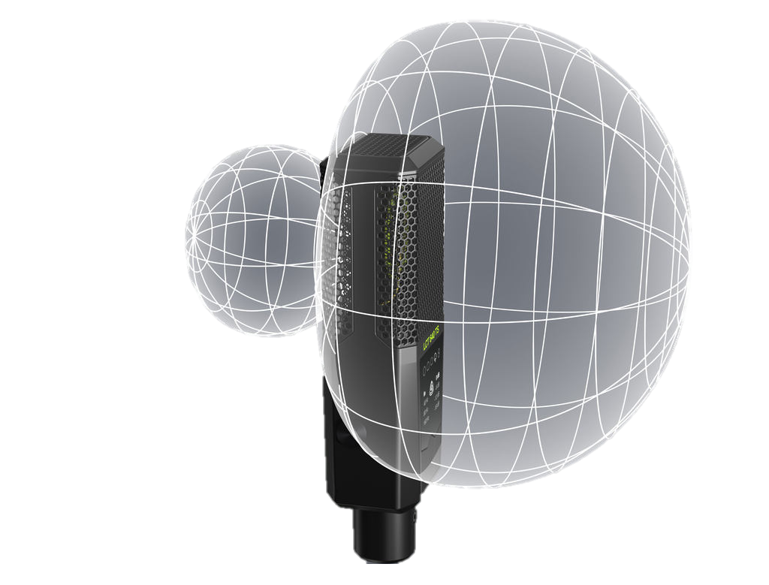
Super-cardioid
More directional compared to just cardioid
Less sensitive from sound from the sides
Picks up sound sound from the rear

Slide 7
Hyper-cardioid/Ultra-cardioid
Very narrow pickup patterns
Least sensitive from sound from the sides
Needs to be placed precisely to the source
Extreme rejection of ambient sound
sources

Slide 8
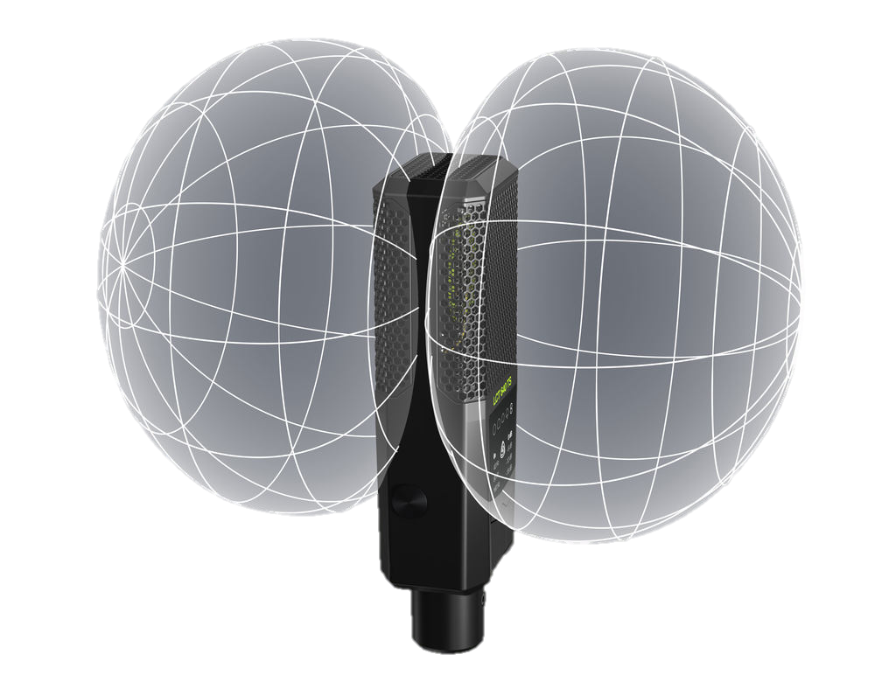
Bi-directional
Figure of eight pattern
Prevents sound bleeding into mic from the side

Slide 9
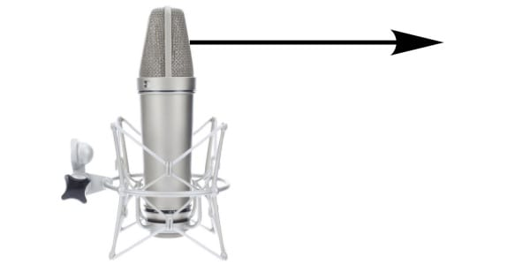

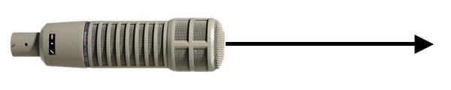
Where To Speak
Microphones can be front-address (AKA top-address) or side-address
  This determines which part of the mic should face the sound source
  Generally, if it is a shotgun or handheld, it is front-address
  Bi-directional mics, ribbon, multi-pattern mics are generally side-address
E.g. Front-addressing condenser mics should be 15-20cm from the mouth and directed slightly above the lips (to avoid smacking sounds)

